Slide 1
My First Document
Part 1 of the Series “Duxbury Braille Translator: from First Paddle to Flocking Flying”
Notes:
Layout: Title Slide

Slide 2
Description
Are you new to Duxbury Braille Translator and unsure where to start? Attend this first in a series of four webinars which provide a structured introduction to Duxbury answering the essential questions: How do I start? Where do I begin? Through step-by-step instruction, you will learn how to navigate the software and create your first braille document. Specifically, this first session lays a foundation for continued skill development, designed for users of Duxbury Braille Translator.

Slide 3

Hello
Kyle DeJute
Braille Trainer at APH
Notes:
Layout: Comparison

Slide 4
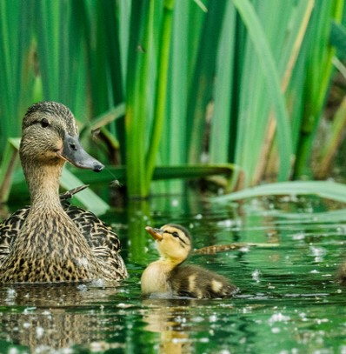
Poll Time! #1
It is time for a poll/quiz!

Slide 5
Poll One!
1. What does DBT stand for?
A. Digital Braille Translator
B. Dux Braille Time
C. Duxbury Braille Translator
D. Duxbury Systems Inc.

Slide 6
Poll One, the Answer!
1. What does DBT stand for?
A. Digital Braille Translator
B. Dux Braille Time
*C. Duxbury Braille Translator*
D. Duxbury Systems Inc.

Slide 7
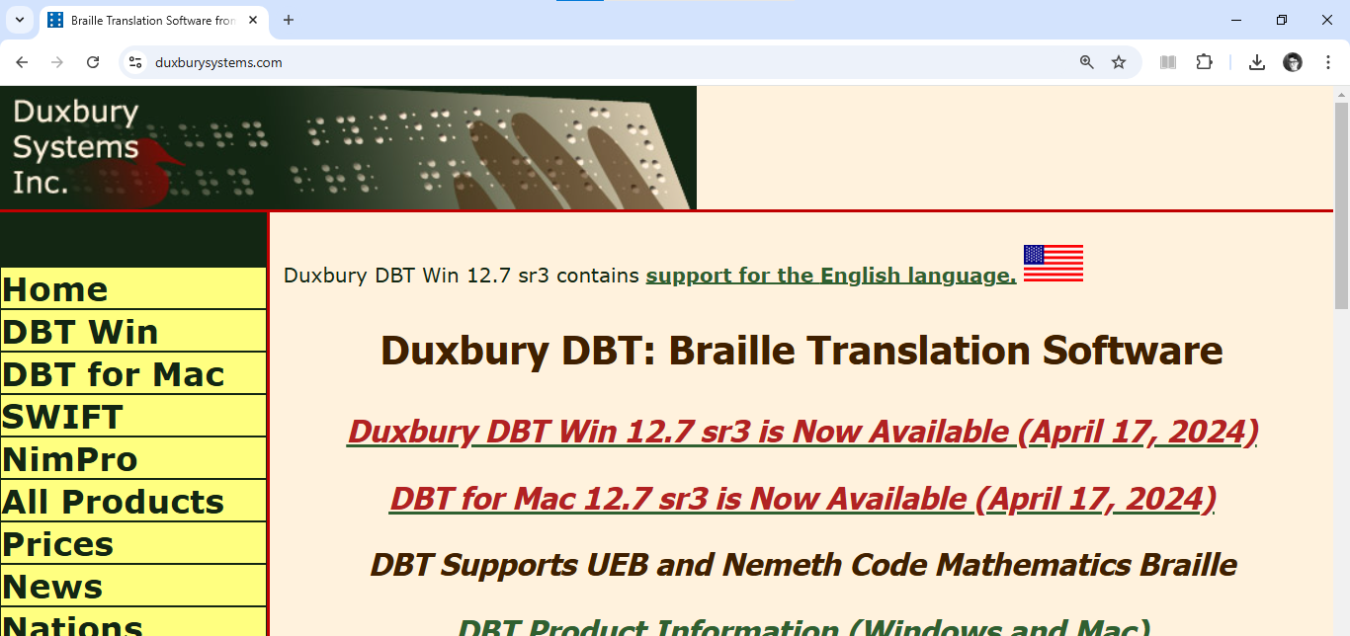
Duxbury Website
https://www.DuxburySystems.com/

Slide 8
Opening the Program
Notes:
Layout: Section Header

Slide 9

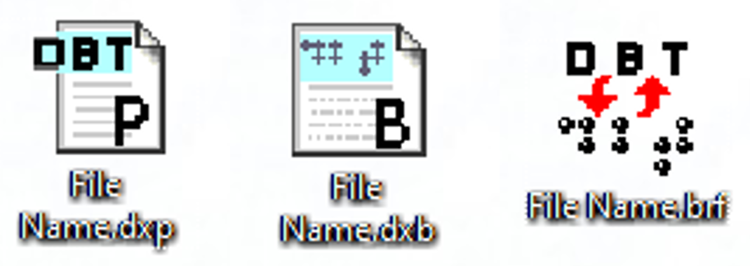
DBT Icons
Program Icon
File Icons

Slide 10
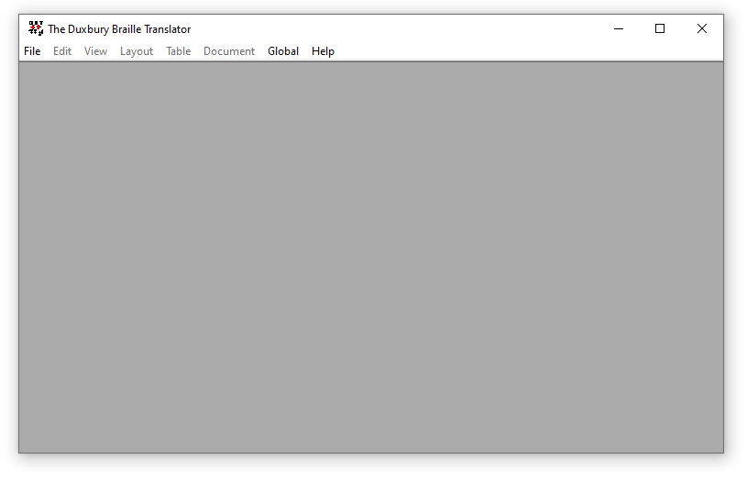
DBT Program Window

Slide 11
Other Ways to Open the Program
program files
file itself, with default program set
SWIFT
… more?

Slide 12
Other Braille Transcription Programs
Of course there are other programs!
BrailleBlaster
Braille2000
Sao Mai Braille (SMB)
…

Slide 13
Starting a New File

Slide 14
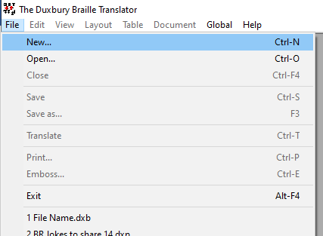
File, New

Slide 15
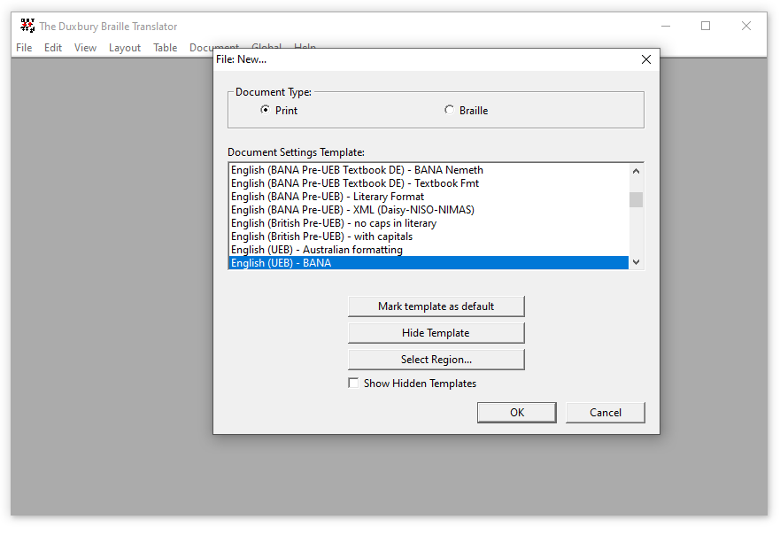
Choosing a Template!

Slide 16
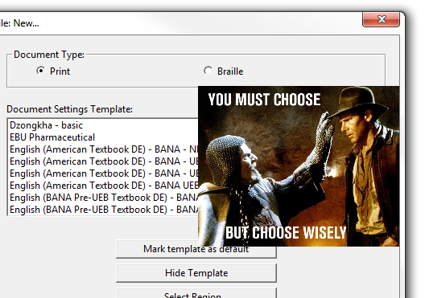
Which Template?
In the U.S., we are likely going to use one of two templates:
  English (UEB) - BANA
  English (UEB) - BANA with Nemeth
In Canada, we are likely going to use only the UEB template above.
…
Can I make my own templates?

Slide 17
Foundations of Duxbury 🔩
In 2022, we presented the webinar Foundations of Duxbury.
That webinar, like this one, introduces Duxbury, but it does so based on a different approach to learning.
In short, Foundations of Duxbury describes the program’s nuts and bolts, while this webinar seeks to provide step-by-step processes for certain tasks within Duxbury Braille Translator. ✔✔

Slide 18
Direct Entry of Print

Slide 19
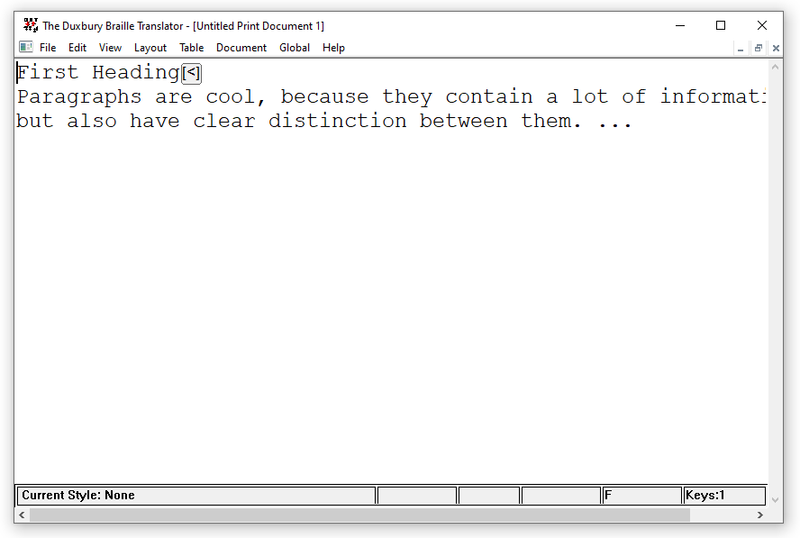

Type or Paste Into a DXP

Slide 20
Poll Time! #2
It is time for a poll/quiz!

Slide 21
Poll Two!
2. True or False? When you first open DBT, it starts with a new file ready.
A. True
B. False

Slide 22
Poll Two, the Answer!
2. True or False? When you first open DBT, it starts with a new file ready.
A. True
*B. False*

Slide 23
Translating or “Where is the braille!?!”

Slide 24
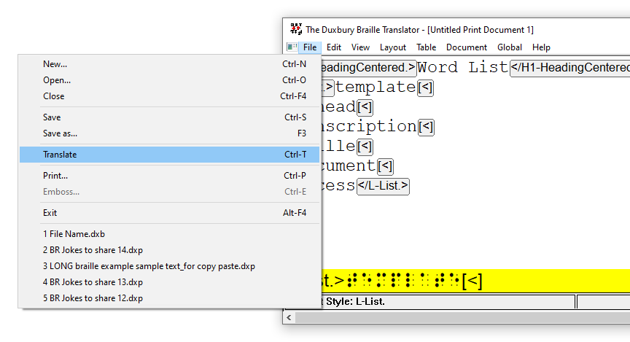
File, Translate
This (or Ctrl-T) translates the file AND CREATES A dxb FILE.

Slide 25

Importance of the “Translate” Command

Slide 26
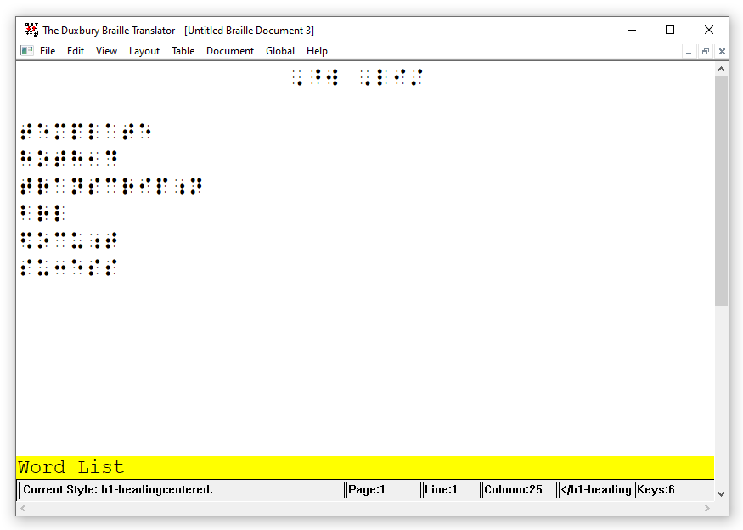
There Is the Braille

Slide 27
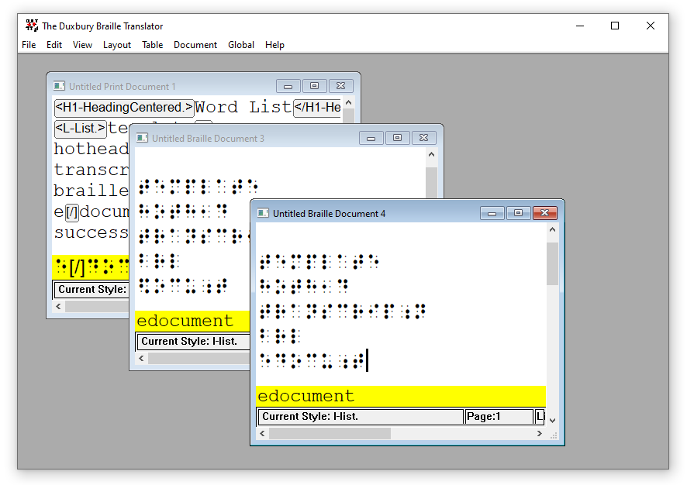
How Much Is That Doggie in the Window?
Every instance of “Translate” creates a new file.

Slide 28
Poll Time! #3
It is time for a poll/quiz!

Slide 29
Poll Three!
3. What is the name of one of the two most commonly used DBT templates in North America?
A. Udmurt - basic
B. English (BANA Pre-UEB Textbook DE) - BANA
C. English (UEB) - BANA
D. English (UEB) - Australian formatting
E. English (UEB) - basic

Slide 30
Poll Three, the Answer!
3. What is the name of one of the two most commonly used DBT templates in North America?
A. Udmurt - basic
B. English (BANA Pre-UEB Textbook DE) - BANA
*C. English (UEB) - BANA*
D. English (UEB) - Australian formatting
E. English (UEB) - basic

Slide 31
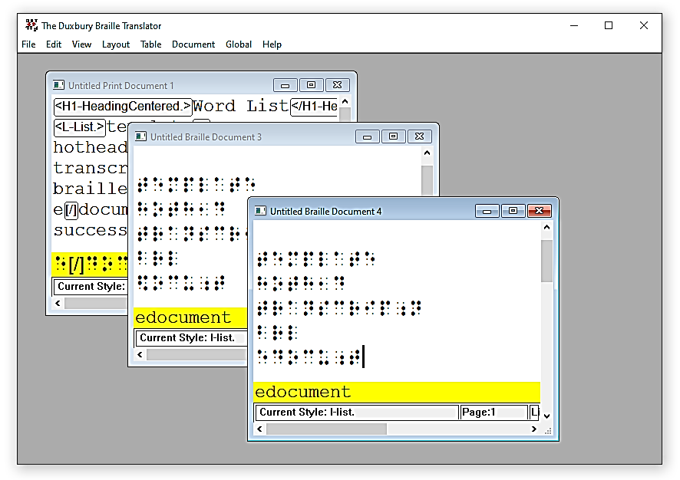
Examination of Multiple Files in One DBT Window
Each file has its own translated line
The translated line has limits to its usefulness
Each file has a distinct name

Slide 32
Saving the File(s)

Slide 33
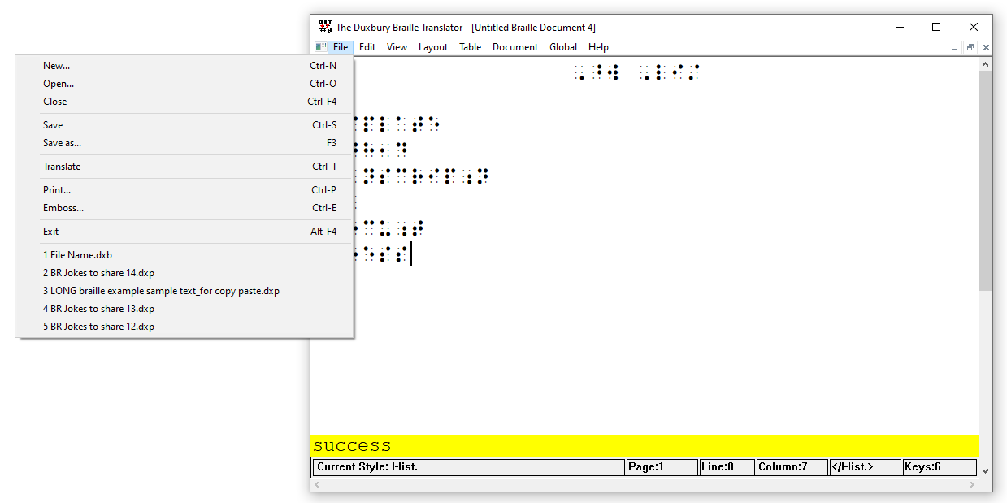
To Save or Save As

Slide 34
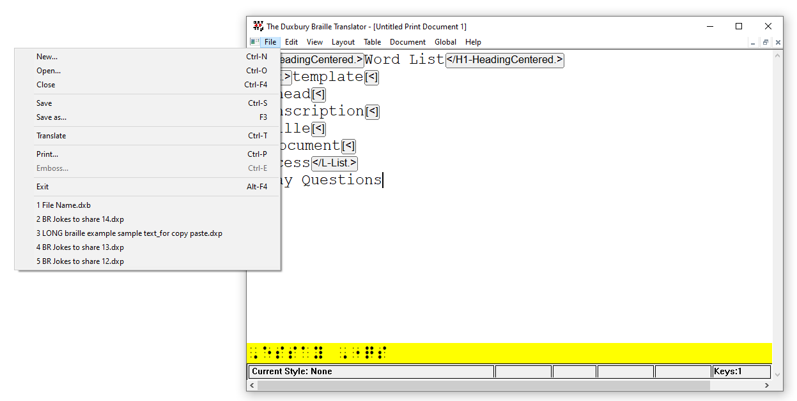
To Save Print or Save Braille

Slide 35

Multiple File Types
One practical workflow is to save each file type along the way in your transcription.

Slide 36
Demonstration and Practice
🦆

Slide 37
Poll Time! #4
It is time for a poll/quiz!

Slide 38
Poll Four!
4. True or False? An edit made to a Duxbury print file changes the connected Duxbury braille file.
A. True
B. False

Slide 39
Poll Four, the Answer!
4. True or False? An edit made to a Duxbury print file changes the connected Duxbury braille file.
A. True
*B. False*

Slide 40
Objectives
Explain that “DBT” stands for “Duxbury Braille Translator,” which is the main software product of the company “Duxbury” or “Duxbury Systems Inc.”
Identify “choosing a template” as an inevitable part of making a document in DBT
Explain that DBT’s braille file is separate from and not connected to DBT’s print file

Slide 41
Parts 2–4 of This Series
March 18, 2025: Working In an Existing Document and Using Microsoft Word
April 15, 2025: Getting Good at Editing
May 20, 2025: Macros and Math

Slide 42
Contact information
Kyle DeJute, kdejute@aph.org
Notes:
Layout: Comparison

Slide 43
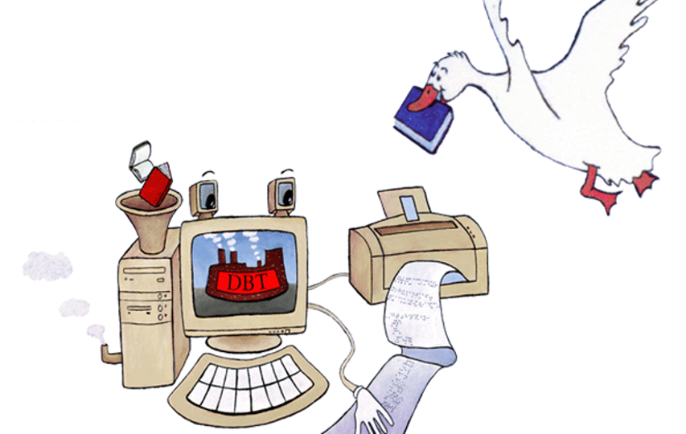
How charming is the Duxbury opening image?!?

Slide 44
BONUS CONTENT
Some Questions and Suggestions From “Foundations of Duxbury,” 2022

Slide 45
Is there a template for a double-spaced document?

Slide 46
Codes to Start and Stop Double Spacing
If you have a document that needs to be double-spaced, I might suggest the DBT code “svsbl1” at the beginning your document.
The code “svsbl0” sets single-spacing.

Slide 47
How to Insert the Double-Spacing Code
You can insert the code “svsbl1” in Duxbury:
via the dialog box that comes up when you press Ctrl+[ or F9
with the keyboard shortcut Shift+F2
via the “Layout” dropdown menu Layout > Line Codes > Double Spacing

Slide 48
Creating a Template for Double Spacing
If you want to get really fancy efficient, you could create a template. In their documentation, Duxbury has a page on creating your own template. Please remember that if you create a new template, it is really helpful to name it in a way that 1) does not replace a native Duxbury template and 2) includes the name of the template on which it is based (e.g., “English (UEB) - BANA, double-space”)

Slide 49
Is there an “uncontracted” template?

Slide 50
Codes to Uncontract and Contract
If you have an entire document that needs to be uncontracted, please let me suggest the DBT code “g1” at the beginning of your document. Or the codes “tx” and then “g1”
The code combination “tx” and “g2” (or keyboard shortcut Alt+2) turns contractions back on within the file.

Slide 51
How to Insert a Code for Uncontracting
You can insert the code “g1” in Duxbury:
via the dialog box that comes up when you press Ctrl+[ or F9
with the keyboard shortcut Alt+1
via the “Layout” dropdown menu Layout > Translation Codes > Grade 1

