Slide 1
Getting Good at Editing
Part 3 of the Series “Duxbury Braille Translator: from First Paddle to Flocking Flying”

Slide 2
Description
Building on what we covered in earlier webinars, we will strengthen your understanding of the working parts of Duxbury Braille Translator (DBT) so you can troubleshoot almost any file. Attend this third in a series of four webinars which provide a structured introduction to Duxbury answering the essential questions, like: Why is this file not working the way I need? What are some ways I can get the math I need? and How could I improve my transcription workflow?

Slide 3

Hello
Kyle DeJute
Braille Trainer at APH

Slide 4
Starting Points

Slide 5
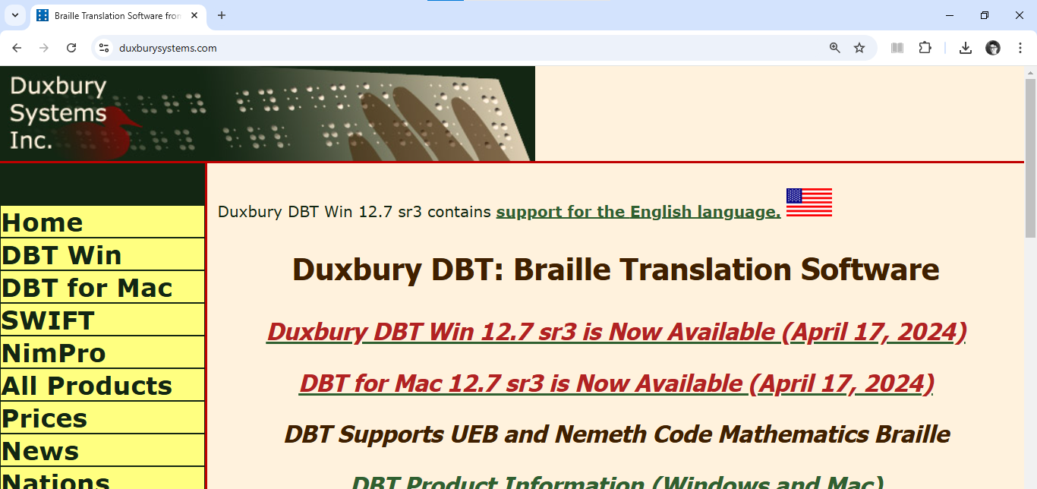
Duxbury Website
https://www.DuxburySystems.com/
Download, FAQ, Help, Listservs, etc.

Slide 6

Vocabulary
DBT
Word
macro
The Nemeth Code
UEB Math/Science [and “UEB with Nemeth”]
NIMAS
Nimpro
…

Slide 7
What exactly are we “getting good at editing?”

Slide 8

Stages of the Transcription Process
Born accessible
Uploaded “as accessibly as I can”
Inherited braille file
…
At different stages, different editing skills may be needed.

Slide 9

What Files Can DBT Import?
See Duxbury’s page DBT File Import
“The phrase file import refers to the act of taking a non-native DBT file and bringing it into DBT for editing and producing braille. There are many different file types that DBT can import. …” For example:
Word
Open Office
MathType
…

Slide 10
A Note About NIMAS Files
NIMAS files and Duxbury’s NimPro
NIMAS, which stands for the National Instructional Materials Accessibility Standard, is a technical standard used by publishers to prepare “electronic files” that are used to convert instructional materials into accessible formats. The “electronic files” are known as NIMAS source files. The purpose of NIMAS is to help increase the availability and timely delivery of instructional materials in accessible formats for qualifying students in elementary and secondary schools.
NimPro processes NIMAS files (and other file types) into a file type that is editable in DBT.

Slide 11
Any Content Will Have Instructions/Codes in DBT
Regardless of where it comes from, math (or any text) is going to get Duxbury instructions/codes.
Accessible .docx? Yes.
  Consider the APH Hive course “Building Accessible Word Documents” 📄⚒️🐝
Run-of-the-mill .docx? Yes.
File from LaTeX editor? Yes.
File created with six-key entry? Yes.
More?

Slide 12
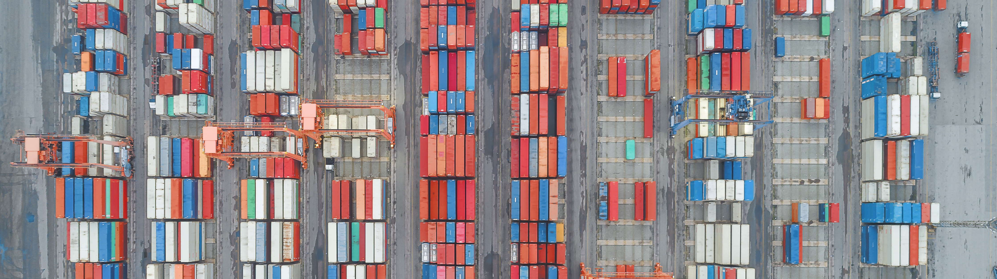
A Word on Accessible Word Processor Files
A well-organized word processor file (e.g., .docx) is an excellent foundation for a braille transcription. A really excellent foundation.

Slide 13

Poll Time! #1
It is time for a poll/quiz!

Slide 14
Poll One!
1. True or False? When working with a Microsoft Word file (or any file from a word processor), you must use the Braille tab and/or a BANA template to complete a braille transcription using DBT.
A. True
B. False

Slide 15
Poll One, the Answer!
1. True or False? When working with a Microsoft Word file (or any file from a word processor), you must use the Braille tab and/or a BANA template to complete a braille transcription using DBT.
A. True
*B. False*

Slide 16
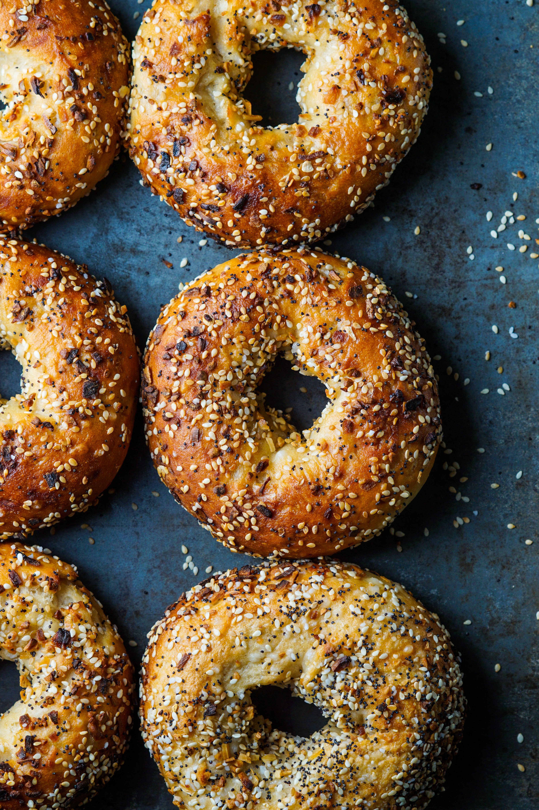
We are getting good at editing … … Everything …

Slide 17

with the end goal of a beautifully edited DBT file

Slide 18
Possible Components of a Beautifully Edited DBT File

Slide 19

We are going to jet through this section of slides

Slide 20

Headings
Centered
  <H1-HeadingCentered.> </H1-HeadingCentered.> (in a BANA template)
  <h1.> </h1.> (in the template “English (UEB) - basic”)
Other headings …
Running
  <RunningHead.> </RunningHead.> (in a BANA template)
  Codes (e.g., to use in the template “English (UEB) - basic”):
  [tls]running head material[tle]
  [svrhp#]
What else?

Slide 21
Page Numbers
Print Page Numbers
Braille Page Numbers
In BANA templates:
  RefPageNumber.
  RefPageNumberEmbed
  pagenum
Codes:
  [lea]page number
  [lec]continuation pg num.
  [led]discontinue pages
[svpnpN:N:N:N] can set placement of all page numbers. The possible values for any N are: 0 for no place, 1 for upper left, 2 for upper right, 3 for lower left, 4 for lower right. The N’s are (in order) braille on odd, braille on even, print on odd, print on even
[pg#] begins a new page and sets the braille page number to #
[pv#~_] sets the braille page number to # and the page prefix character to _

Slide 22
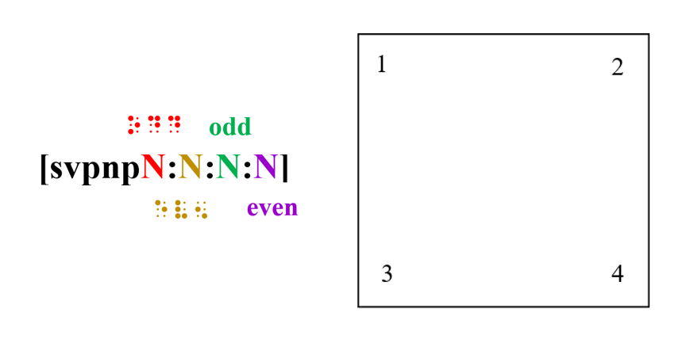
Visual Mnemonic for svpnpN:N:N:N

Slide 23
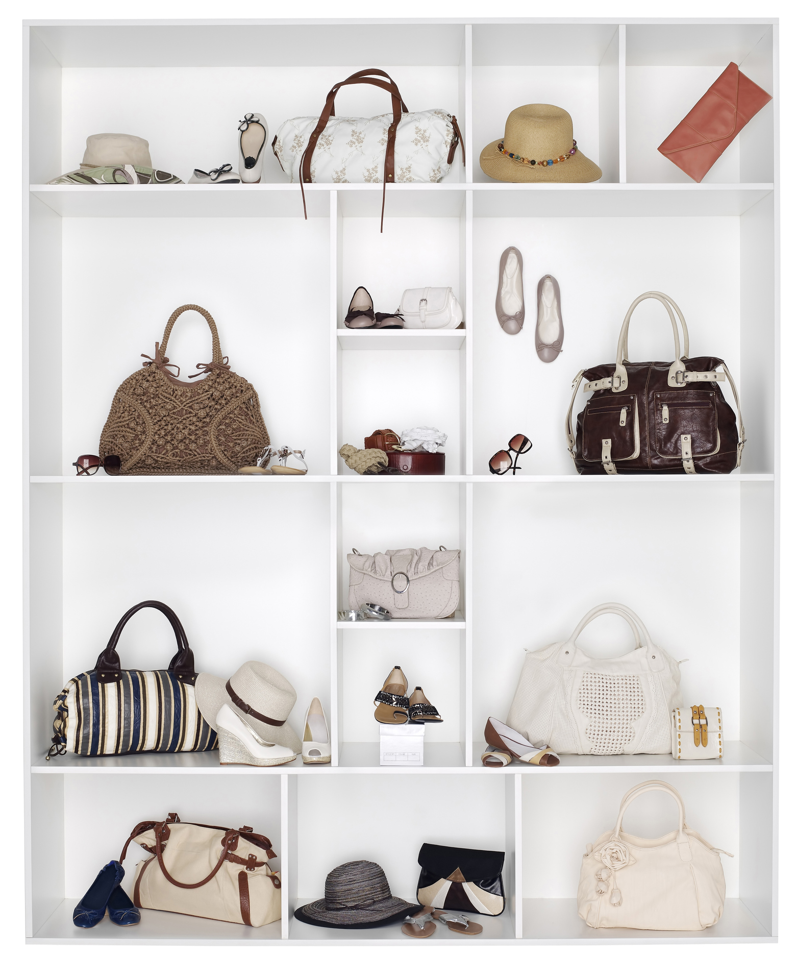
Blank Lines
Codes:
  sk
    [sk1] or [sk2] or [sk12] … etcetera
    [skn] nullifies a blank line
  sc
    [scL:M:N:P] is a template for conditional line skips
Blank line codes are often “packed into” a paragraph style.

Slide 24

Things Kept Together
Examples
  Heading and text that follows it
  Poetic lines in a stanza
  Table of columns and rows
Some Codes for Protecting (aka “keep together”)
  [:] and [;] keep together on a braille line
  [kps] and [kpe] keep blocks together on a braille page
Protect codes are often “packed into” a style.

Slide 25
Paragraphs and Lists
These can be styled via numbered and/or named styles.

Slide 26

And More …
Footers
Graphics
Tables
What else?

Slide 27
Demonstration, including “Modify Style”
🦆

Slide 28
Poll Time! #2
It is time for a poll/quiz!

Slide 29
Poll Two!
2. To examine what codes make up a paragraph style, we should use which of the following?
A. Find
B. Modify Style
C. Apply Style
D. Sixlets

Slide 30
Poll Two, the Answer!
2. To examine what codes make up a paragraph style, we should use which of the following?
A. Find
*B. Modify Style*
C. Apply Style
D. Sixlets

Slide 31
What About Word’s Braille Tab?

Slide 32
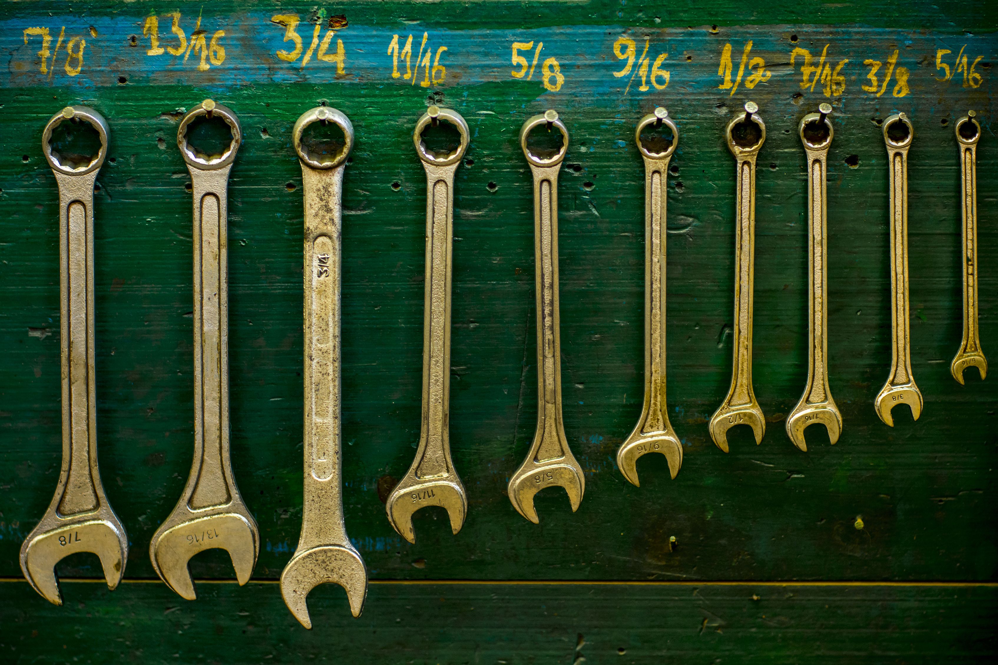
Braille Tab Is Macros

Slide 33
Making Macros

Slide 34
What is a macro?
“a single instruction that expands automatically into a set of instructions to perform a particular task”
…
It’s a shortcut.

Slide 35

In Word!
Choose “Record Macro” somewhere on Word’s Ribbon (perhaps under the View tab, in the Macros group) and then perform your macro using measurable clicks and keyboard strikes.
See also “Create or run a macro,” from Windows

Slide 36
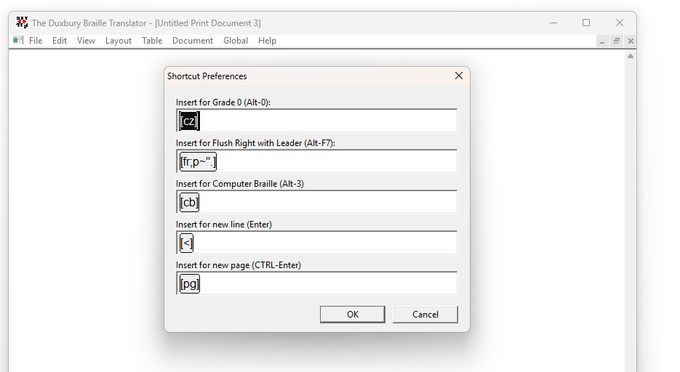
In DBT?
In the “Global” dropdown menu, choose “Shortcut Preferences,” and edit as you dare.

Slide 37
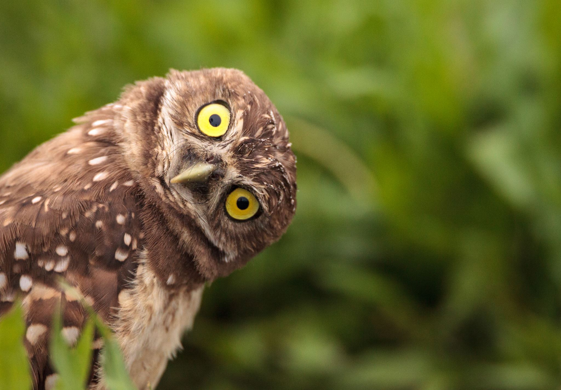
Can a Macro Be Edited?
Sure. Though, honestly, that is currently outside my expertise.
But, …
I bet it is not outside your capabilities!

Slide 38
Poll Time! #3
It is time for a poll/quiz!

Slide 39
Poll Three!
3. What is a macro?
A. a kind of pasta
B. a kind of shortcut
C. an overview of styles used

Slide 40
Poll Three, the Answer!
3. What is a macro?
A. a kind of pasta
*B. a kind of shortcut*
C. an overview of styles used

Slide 41
Math Coding

Slide 42
Any Content Will Have Instructions/Codes in DBT (repeat)
Regardless of where it comes from, math (or any text) is going to get Duxbury instructions/codes.
Accessible .docx? Yes.
  Consider the APH Hive course “Building Accessible Word Documents” 📄⚒️🐝
Run-of-the-mill .docx? Yes.
File from LaTeX editor? Yes.
File created with six-key entry? Yes.
More?

Slide 43

Translate to Discover
When you know the braille but not the codes, translating from braille may reveal useful codes and styles

Slide 44
Fraction Codes
[fs] then [fl] and last [fe]
fraction start then fraction line and last fraction end

Slide 45
Geometry Codes and Characters, a few
[e] modified material [os] modifier that is above [oe]
Some modifiers:
  [bar]
  →
  ↔
Many shapes have a Unicode character that will translate correctly.

Slide 46
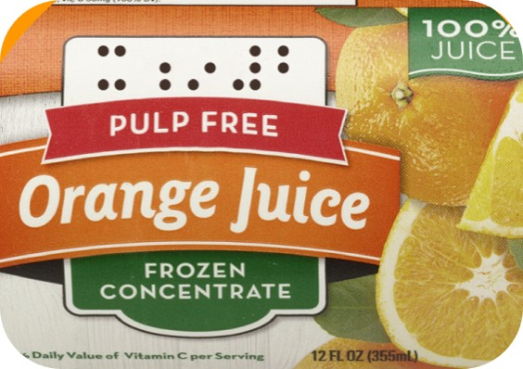
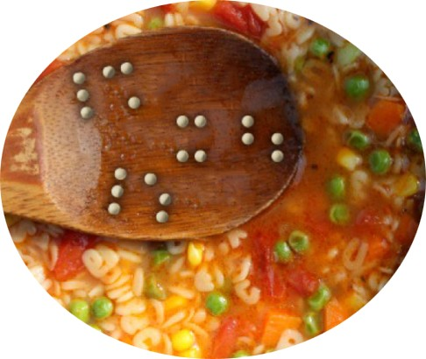
Math Codes Work for UEB *and* Nemeth!!!

Slide 47

For a Nemeth Code transcription, …
… remember to put your Nemeth Code content in math bubbles
<math> </math>

Slide 48
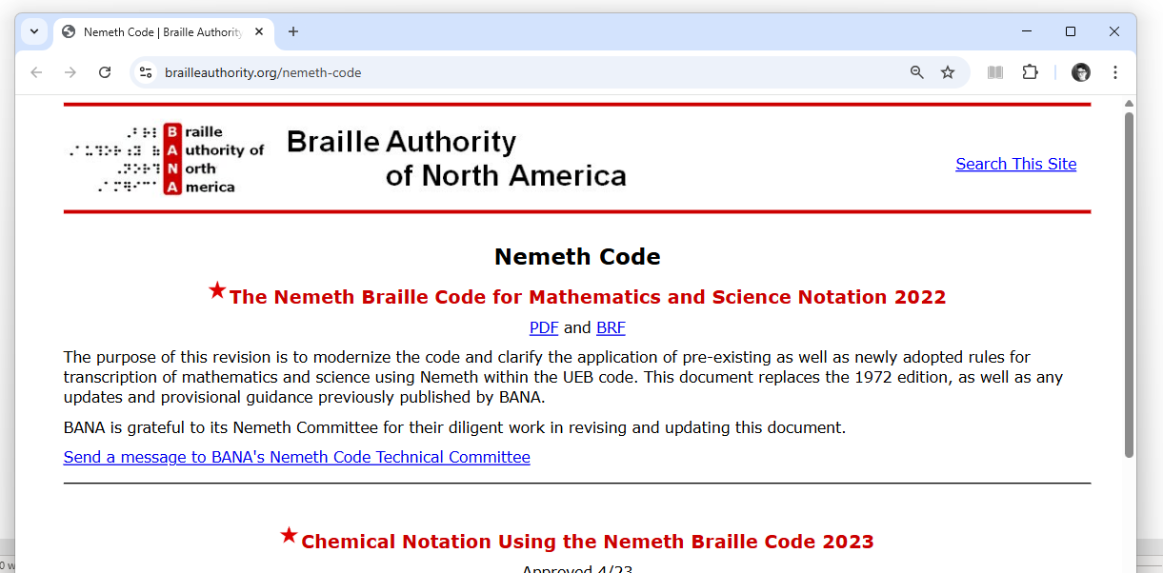
BANA’s page on The Nemeth Code
BrailleAuthority.org/Nemeth-Code

Slide 49
Poll Time! #4
It is time for a poll/quiz!

Slide 50
Poll Four!
4. Which option best completes the following phrase? Codes applied within one DBT template ____.
A. will only work within that template
B. will mostly disappear in another template
C. will mostly work in other templates

Slide 51
Poll Four, the Answer!
4. Which option best completes the following phrase? Codes applied within one DBT template ____.
A. will only work within that template
B. will mostly disappear in another template
*C. will mostly work in other templates*

Slide 52
And So Much More …
Superscripts and Subscripts
Grade 1 mode
...

Slide 53
Demonstration and Practice 🦆

Slide 54
Resources Related to Math in Braille
NFB’s page on Mathematics (Nemeth) Braille Transcription
ICEB’s page on UEB
APH’s UEB Math Tutorial and Nemeth Tutorial, too
NBA
FIMC
CTEBVI
…

Slide 55
Objectives
Explain how to show/hide codes in DBT.
Define “macro” in terms of Microsoft Word (i.e., a single instruction that expands automatically into a set of instructions to perform a particular task).
Explain that a macro can be edited.
Explain how using codes makes it possible to efficiently prepare both UEB and UEB-with-Nemeth transcriptions for one document.

Slide 56
Contact information
Kyle DeJute, kdejute@aph.org

Slide 57
Other Parts of This Series
My First Document, recording on APH’s YouTube page
Working In an Existing Document and Using Microsoft Word, recording on APH’s YouTube page
Today (April 15, 2025): Getting Good at Editing
May 20, 2025: Macros and Math

Slide 58
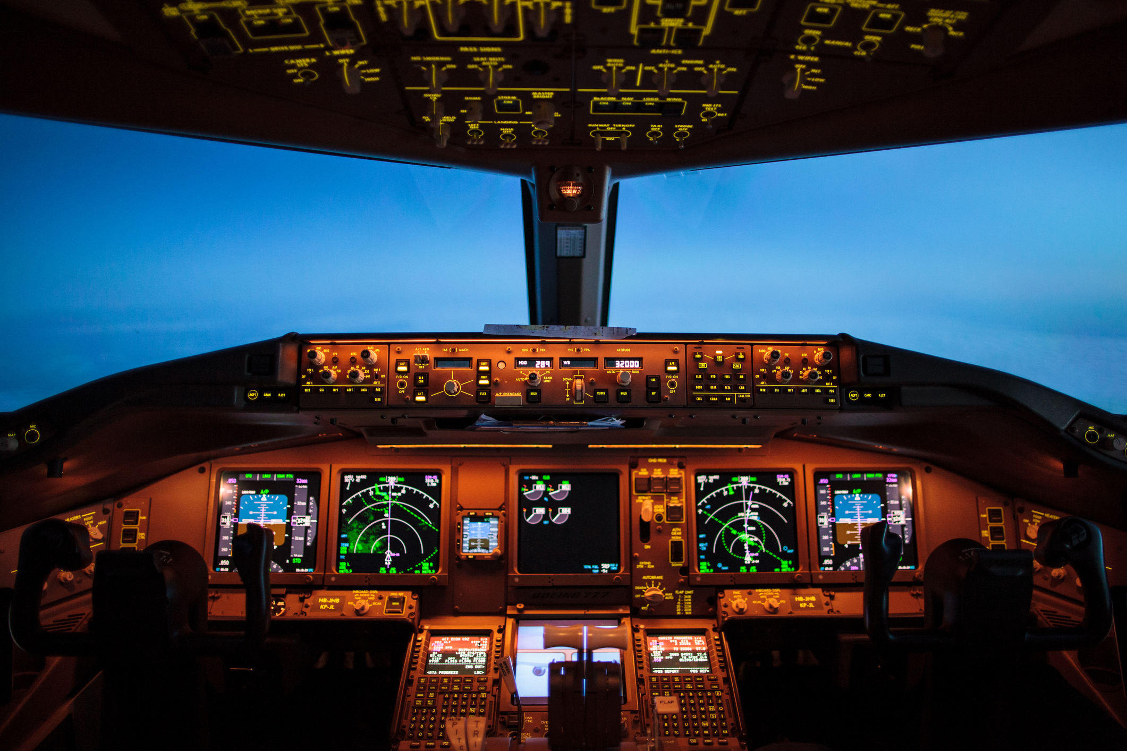
*You* Are Using DBT

